Slide 1



Bio-Behavioral Model to Assess and Treat Severe Complex Challenging Behavior: Application and Empirical Evidence
Eric Boelter, PhD, BCBA-D, Clinical Director, Biobehavioral Inpatient Program, Seattle Children’s Hospital
Clinical Professor, University of Washington School of Medicine

Slide 2
Learning Objectives
Brief Review of Bio-behavioral model
Review how model is applied in an inpatient setting focused on BCBA role
Discuss how model uses evidence-based behavior analytic research in clinical practice and why it is important for BCBAs

Slide 3
Youth Admitted to Bio-Behavioral Inpatient Program
Children with developmental and intellectual delays
Primary concern is severe disruptive behavior
Disruptive behavior a barrier to the child receiving other services
Moderate to severe language delays
Often have medical complications and/or are on several psychiatric or other medications

Slide 4
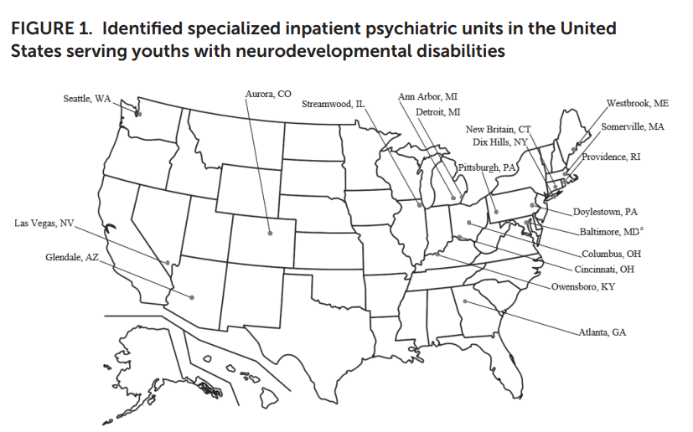
Raising the Bar: Growth of Specialized Hospital Psychiatric Units for Youths with Neurodevelopmental Disabilities
Siegel et al. (2025). Psychiatric Services

Slide 5
Characteristics of Bio Bx Teams (N=13)
Discipline (Core Team) | Percent of Biobx Units
Child Psychiatry | 100%
Social Work | 100%
BCBA | 92%
Psychologist | 62%
SLP | 62%
OT | 54%
Spec Education | 46%
Discipline (Available Consult) | Percent of Biobx Units
PT | 100%
Neurologists | 47%
GI | 31%
Genetics | 71%
Pediatricians | 62%

Slide 6
Clinical Relevance
Interdisciplinary teams allow for more comprehensive and prescriptive treatment planning and have been well established as improving patient care and family satisfaction (Ghebrenhiwet et al. 2016)

Slide 7
Guidelines and Things to Think About
Initially each team member needs to focus their assessment/treatment on the immediate reduction of the severe behavior as primary goal.
Team members don’t need to do everything. Rely on expertise of other members

Slide 8
Biobehavioral Treatment Team Roles
Biologic/Medical: diagnose/treat underlying psychiatric issues; assess/treat underlying medical complications
Skill-based: eval/recs communication (SLP); eval/recs sensory/motor- Occupational Therapy (OT)
Behavioral: understanding/manipulating antecedents/consequences in environment to identify function of severe behavior and evaluate treatment components.

Slide 9
Role of the Behavior Analyst
Bio-Behavioral Model

Slide 10
Applied Behavior Analysis (ABA)
The process of:
Applying principles of behavior (e.g., reinforcement) to specific behavior
Evaluating whether any changes that occur are indeed due to treatment application (single-case design)
Change socially significant behavior to a meaningful degree
Baer, Wolf, & Risley (1968)

Slide 11

Behavior-Environment Interaction
Stimulus or Event Antecedent | Response Behavior | Stimulus change Consequence
Biology: Sensory Sensitivity, sleep, physiology, medication
Learned history: Skill repertoire/deficits, Trauma, family experiences
Culture: Language, food traditions, social tendencies
Specific response emitted
What precedes the response
What follows the response
People
Task
Setting
Pain
Effort
Duration
Latency
Magnitude
Extinction (no change)
Punishment
Reinforcement

Slide 12
Behavior Analytic Assessment
Complete a Functional Behavioral Assessment (FBA) to identify the environmental variables that maintain the disruptive behavior (i.e., function(s) of behavior)
Develop and evaluate a function-based treatment
Use information from other team member’s assessments in your own behavior analytic assessments
Assist in data collection to identify other treatment effect (e.g., medication, sensory) to help team track progress

Slide 13
Function of Behavior
Escape/avoidance (e.g., aggression to escape work)
Gain Attention (e.g., aggression when mom on phone)
Gain Tangible (e.g., Self-Injury for a toy)
Sensory/Automatic (e.g., Self-Injury that appears repetitive)

Slide 14
What’s Involved in a Functional Behavior Assessment?
Indirect Assessment
Direct Assessment/ Observation
Functional Analysis
Why Behavior occurs? FUNCTION

Slide 15
Rationale for Treatments Based on Function
When function of problem behavior is known, treatment involves:
  Interrupting the behavior-reinforcer relation
  Providing known reinforcer for desired behavior

Slide 16
BCBA -Psychiatrist
Collaboration

Slide 17
Behavior-Environment Interaction
Stimulus or Event Antecedent | Response Behavior | Stimulus change Consequence
Biology: Sensory Sensitivity, sleep, physiology, medication
Learned history: Skill repertoire/deficits, Trauma, family experiences
Culture: Language, food traditions, social tendencies
Specific response emitted
What precedes the response
What follows the response
People
Task
Setting
Pain
Effort
Duration
Latency
Magnitude
Extinction (no change)
Punishment
Reinforcement

Slide 18
Medications as Motivating Operations
MO: Antecedents that momentarily alters value of reinforcer and all stimuli and behaviors historically associated with gaining that reinforcer. (Laraway et al., 2003)
EO AO
Changes in challenging behaviors following psychotropic medication administration have been conceptualized as changes to MOs (Valdovinos et al 2009)

Slide 19
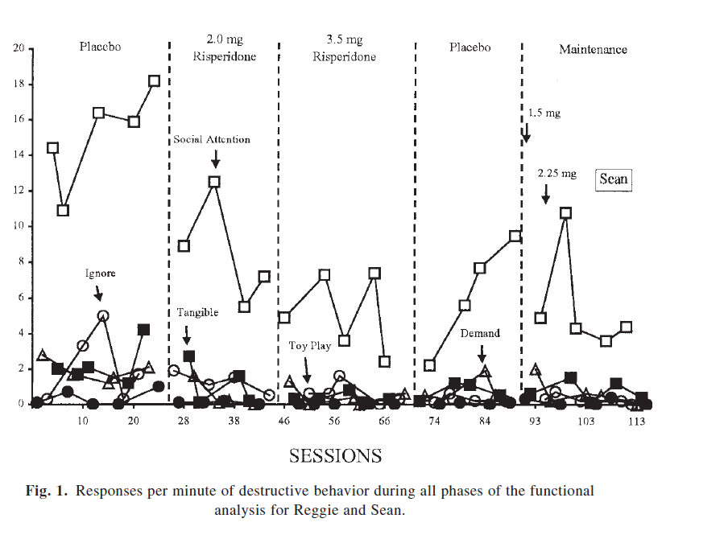
Medication as Motivating Operations
Crosland, Zarcone, Lindauer, Valdovinos et al. (2003)

Slide 20
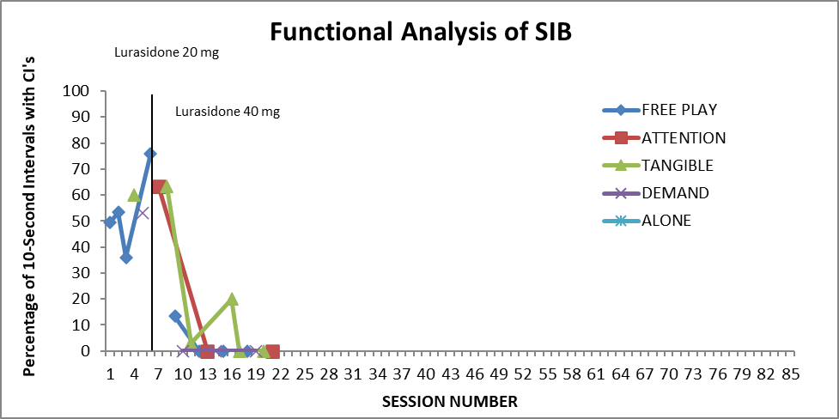
Medication as Motivating Operations

Slide 21
BCBA and Speech Language Pathologist
Collaboration

Slide 22
Behavior-Environment Interaction
Stimulus or Event Antecedent | Response Behavior | Stimulus change Consequence
Biology: Sensory Sensitivity, sleep, physiology, medication
Learned history: Skill repertoire/deficits, Trauma, family experiences
Culture: Language, food traditions, social tendencies
Specific response emitted
What precedes the response
What follows the response
People
Task
Setting
Pain
Effort
Duration
Latency
Magnitude
Extinction (no change)
Punishment
Reinforcement

Slide 23
Example of Collaboration
SLP Evaluates language and communication deficits and strengths, best mode of communication
BCBA uses best mode of communication when completing empirically validated treatment of FCT (Kurtz et al., 2011) and reinforcement schedule thinning following FCT (Hagopian et al., 2011; Kranak & Brown, 2024)

Slide 24
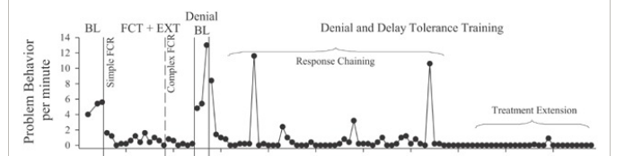
FCT and Schedule Thinning
Hanley et al., 2014

Slide 25
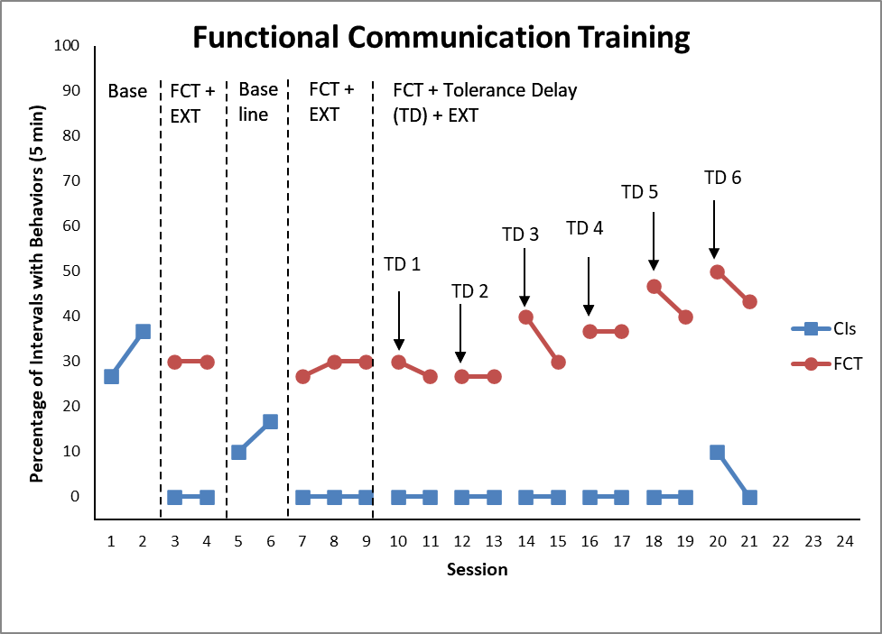
FCT and Schedule Thinning

Slide 26
BCBA Occupational Therapist
Collaboration

Slide 27
Behavior-Environment Interaction
Stimulus or Event Antecedent | Response Behavior | Stimulus change Consequence
Biology: Sensory Sensitivity, sleep, physiology, medication
Learned history: Skill repertoire/deficits, Trauma, family experiences
Culture: Language, food traditions, social tendencies
Specific response emitted
What precedes the response
What follows the response
People
Task
Setting
Pain
Effort
Duration
Latency
Magnitude
Extinction (no change)
Punishment
Reinforcement

Slide 28
Example of Collaboration
OT develops a sensory profile identifying sensory sensitivity
BCBA uses information from sensory profile to run a competing stimulus assessment for SIB maintained by automatic reinforcement (Haddock & Hagopian, 2020)

Slide 29
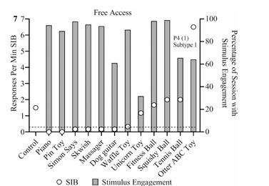
Competing Stimulus Assessment
Frank-Crowford et al., 2023

Slide 30
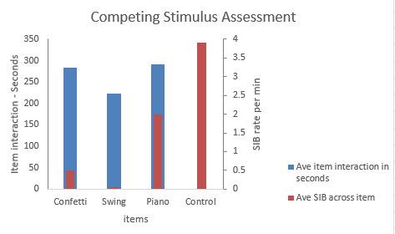
Competing Stimulus Assessment

Slide 31
Summary
Interdisciplinary teams are useful when assessing and treating children with IDD due to complexity of communication and sensory differences, medical/psychiatric comorbidties, and environmental variables that all can contribute to the emergence and maintenance of disruptive behaviors

Slide 32
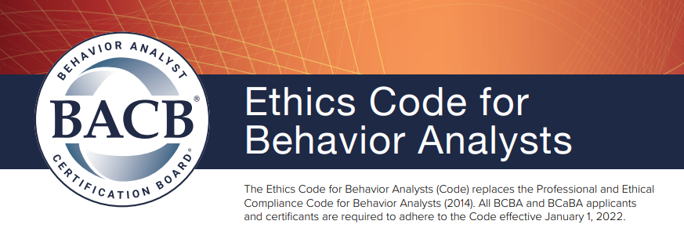
BACB Ethics Code
Requires reliance on scientific evidence in assessment
“Before selecting or designing behavior-change interventions behavior analysts select and design assessments that are conceptually consistent with behavioral principles; that are based on scientific evidence; and that best meet the diverse needs, context, and resources of the client and stakeholders.” BACB 2.13 (Selecting Designing and Implementing Assessments)

Slide 33
References
Baer BM, Wolf MM, Risley TR. Some Current Dimensions of Applied Behavior Analysis. Journal of Applied Behavior Analysis.1968;1:91-97.
Crosland KA, Zarcone JR, Lindauer SE, et al. Use of functional analysis methodology in the evaluation of medication effects. Journal of Autism and Developmental Disorders. 2003;33(3):271-279.
Frank‐Crawford, M. A., Hagopian, L. P., Schmidt, J. D., Kaur, J., Hanlin, C., & Piersma, D. E. (2023). A replication and extension of the augmented competing stimulus assessment. Journal of Applied Behavior Analysis, 56(4), 869-883.
Ghebrehiwet, T., Ammon, M., Burbiel, I., Botbol, M. (2016). Interdisciplinary Team Approach to Clinical Care. In: Mezzich, J., Botbol, M., Christodoulou, G., Cloninger, C., Salloum, I. (eds) Person Centered Psychiatry. Springer, Cham. https://doi.org/10.1007/978-3-319-39724-5_16
Haddock, J. N., & Hagopian, L. P. (2020). Competing stimulus assessments: A systematic review. Journal of Applied Behavior Analysis, 53(4), 1982-2001.
Hagopian, L. P., Boelter, E. W., & Jarmolowicz, D. P. (2011). Reinforcement schedule thinning following functional communication training: Review and recommendations. Behavior Analysis in Practice, 4(1), 4-16.
Hanley, G. P., Jin, C. S., Vanselow, N. R., & Hanratty, L. A. (2014). Producing meaningful improvements in problem behavior of children with autism via synthesized analyses and treatments. Journal of Applied Behavior Analysis, 47(1), 16-36.
Kranak, M. P., & Brown, K. R. (2024). Updated recommendations for reinforcement schedule thinning following functional communication training. Behavior Analysis in Practice, 17(1), 87-106.
Kurtz, P. F., Boelter, E. W., Jarmolowicz, D. P., Chin, M. D., & Hagopian, L. P. (2011). An analysis of functional communication training as an empirically supported treatment for problem behavior displayed by individuals with intellectual disabilities. Research in Developmental Disabilities, 32(6), 2935-2942.
Laraway, S., Snycerski, S., Michael, J. and Poling, A. (2003), MOTIVATING OPERATIONS AND TERMS TO DESCRIBE THEM: SOME FURTHER REFINEMENTS. Journal of Applied Behavior Analysis, 36: 407-414. https://doi.org/10.1901/jaba.2003.36-407
Valdovinos, M. G., Nelson, S. M., Kuhle, J. L., & Dierks, A. M. (2009). Using analogue functional analysis to measure variations in problem behavior rate and function after psychotropic medication changes: A clinical demonstration. Journal of Mental Health Research in Intellectual Disabilities, 2(4), 279-293.

