Slide 1

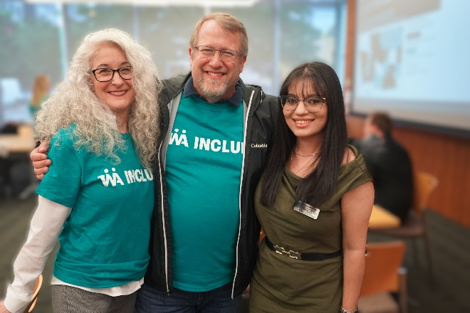
An Introduction to Project ECHO through WA INCLUDE
ECHO IDD Wraparound: Sept 9, 2026
Karís Casagrande, PhD
Washington INCLUDE Collaborative: Research and Evaluation Lead
University of Washington: Assistant Professor in Psychiatry and Behavioral Sciences
Seattle Children’s Hospital: Clinical Psychologist at the Autism Center
No relevant financial disclosures or conflicts of interest
www.wainclude.org

Slide 2
Objectives
After today’s “knowledge burst,” you should be able to:
Share the origin of the Project ECHO model at UNM and WA INCLUDE
List the 4 core components of the ECHO
Describe the ECHO session structure and participation guidelines

Slide 3

What is Project ECHO?
Project ECHO (Extension for Community Healthcare Outcomes) is a professional education and capacity-building model developed at the University of New Mexico by Dr. Sanjeev Arora in 2003.
It emphasizes the development of learning communities to share specialized knowledge between experts and professionals in local communities. ECHO has been implemented in almost every country and has over 900 published peer-review articles, making it an evidence-based program with a global impact in knowledge, confidence, and skills.
“Move Knowledge, Not People”—bringing expertise to community-based providers rather than requiring patients or providers to travel to specialists.
Copyright © ECHO Institute
https://projectechoannualreport.unm.edu/
https://projectecho.unm.edu/
Notes:
Project ECHO, which stands for Extension for Community Healthcare Outcomes, is a specific type of learning collaborative that focuses on utilizing technology to improve care for traditionally underserved populations or conditions.
ECHO was first developed at UNM by Dr. Sanjeeve Aurora in 2003 to address his long waitlist for care related to Hepatitis C
The ECHO philosophy is based on the fact that there are often not enough specialty care providers to treat those with complex conditions out in the community, and thus aims to train primary care clinicians to provide that care through this learning collaborative so patients can get the right care in the right place at the right time.

Slide 4
ECHO Expansion
2003
Project ECHO launched at UNM for Hepatitis C care
2015
ECHO Autism for PCP autism diagnosis & care management
2021
Expansion of ECHO to support WISe with IDD Wraparound
2025
ECHO Complex Behavior for high support needs
2003+
ECHO expanded to other complex medical conditions
2019
ECHO Autism brought to Washington as follow up to COE
2022
Additional ECHOs for I/DD resource navigation and psychiatric care

Slide 5
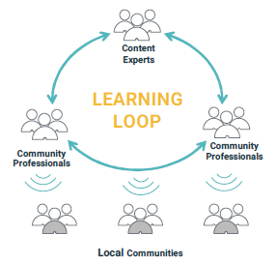

ECHO is a Learning Collaborative
“All Teach, All Learn”
ECHO connects a team of content experts (the “hub”) with community professionals (the “spokes”)
Multi-directional learning occurs over time, building knowledge of best practice and community context.
Establish networks which can be spread to the wider community increasing access to care and resources
Notes:
In addition to “moving knowledge, not people” ECHO also uses the phrase “All Teach, All Learn” to emphasize that this is learning collaborative. ECHO programs create communities of practice that connect specialists or subject-matter experts (the “hub”) with community-based professionals (the “spokes”). Over the course of the ECHO series, the hub and spokes learn from each other to build up knowledge both of professional best practice, but also of the local context and needs of specific communities. This creates a greater capacity to support local communities through access to informed care and resources specific to their needs.
In simple terms, an ECHO program takes knowledge that is concentrated in a small number of experts and spreads it through a network of local professionals who cause that knowledge to serve more people in their own communities.

Slide 6
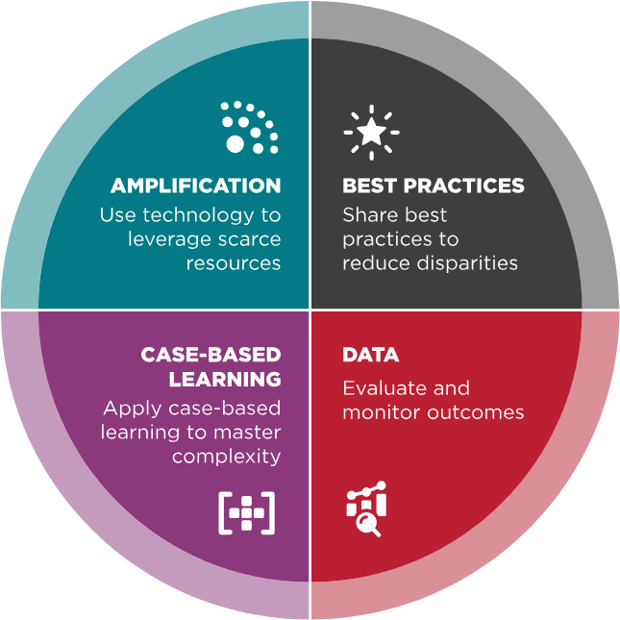
Key Principles of ECHO
Notes:
There are a variety of ways that learning collaboratives are run, but ECHO is specifically guided by four core principles that define the structure.
First, sessions use technology like Zoom to connect so that knowledge can more easily be spread over long distances.
Second, the space is used to share best practice in a specific area of practice through short didactics, sometimes called “knowledge bursts,” and other discussions
Third, case-based learning is used as a form of guided practice to support participants in applying learned information and navigating the complexity of their real-world cases.
Last, outcomes like attendance, engagement, and learning in monitored to ensure ongoing quality improvement and accountability for expected outcomes.

Slide 7
The ECHO Session Structure (90-minute session)
Introductions & Announcements - 15 min
Didactic (AKA “knowledge burst”) – 20 min
Case Presented by a Participant – 10 min
Clarifying Questions (participants then hub) – 15 min
Recommendations (participants then hub) – 25 min
Notes:
Each ECHO session starts with introductions, so that we continue to grow our community by creating strong networks. We also share announcements of other events or learning opportunities that are relevant to the work we are doing together.
Sessions also include a short didactic, which some groups call “Knowledge bursts” which are meant to help share an area of best practice that can spark your interest and get you started with learning more in the future.
Lastly, the majority of the session is dedicated to case-based learning, which includes a short case presentation, time for clarifying questions, and sharing recommendations based on the needs of the case.

Slide 8
Your WA INCLUDE ECHO team
The HUB team
Coordinator
Responsible for program logistics, communication, day to day operations, & connecting participants
Facilitator
Leads sessions, moderates discussions, and supports or mentors participants
Content Area Experts
A multi-disciplinary team sharing knowledge of best practice, resources, and mentorship
Includes self and family advocates!

Slide 9
More about this ECHO series
ECHO COMPLEX BEHAVIOR
WHAT
WHO
HOW
  Provides multidisciplinary education, training, and mentorship to
  professionals supporting youth with intellectual and developmental disabilities (I/DD) and high-level behavioral, communication, and psychiatric support needs.
  Providers, educators, advocates, BCBAs, SLPs, OT, physicians, mental health providers, educators, care coordinators, advocates, and other professionals
  Expert-led education on behavioral supports for youth with Autism and/or IDD
  Real-world case discussions to improve clinical skills
  A network for shared learning and expert guidance

Slide 10
Other WA INCLUDE ECHO Programs
ECHO Autism:
Foundations for Evaluation
1st & 3rd Wednesdays, 12pm-1pm
For providers and support teams who are new to the Autism Center of Excellence (COE) role
ECHO Autism:
Advanced Practice
4th Wednesdays, 12pm-1pm
Designed for more advanced COE providers seeing case with greater complex needs or presentations.
ECHO IDD Psychiatric Care
1st Wednesday, 8:30-10am
Supporting Washington State providers managing the psychiatric care of youth and young adults with I/DD and behavioral health needs
ECHO IDD Resources
3rd Wednesday, 8:30-10am
A forum for sharing knowledge, building connections, and bridging the gap between providers, families, and the resources available to them
ECHO Complex Behavior
1st & 3rd Mondays, 3:30-5pm
Multidisciplinary education, training, and mentorship to professionals supporting youth with IDD and high-level behavioral, communication, and psychiatric support needs
ECHO Community Sessions
2nd Friday, 12-1pm
More in-depth didactics open to all WA INCLUDE members. Topics rotate based on current community needs and interests.
To register visit our website: www.WAINCLUDE.org wainclude@uw.edu

Slide 11


So how do you participate?
Be engaged and respectful
Keep cameras on when possible
Attend sessions regularly
Engage in respectful discussion
Be an active listener and collaborator
Keep comments brief and focused
Reduce discussion in the chat
Protect the privacy and dignity of the cases and recommendations shared
Be strengths-based and affirming
Present a Case
Engage in collaborative problem solving
Ask Clarifying Questions
Ask questions to increase understanding
Keep questions focused on clarification or gathering new or missing information
Make Recommendations
Share evidence-based recommendations
Keep recommendations focused on the needs and reality of the case context
Give Feedback
Let us know what is or isn’t working!
ECHO Participant Guide
Notes:
Be engaged and respectful. We are building a community of people learning together, so it is helpful to see each other. Also, attending regularly and being respectful of different experiences, knowledge, and perspectives is critical to being an active listener and collaborator. Sessions are jam packed with learning and discussion, so please try to keep comments on topic and to the point, so we can engage in rich deep discussions without veering too far off track. Additionally, when there is too much happening in the chat, it can distract from the presentation and live discussion so keep discussions there to a minimum.
Ask Clarifying Questions. Ask brief questions to better understand the case context and specific needs before offering recommendations. Examples - What is the main goal or concern? What has already been tried? How long has this been happening? What supports are available?
Recommendations should consider what was learned about during presentation and clarifying questions and best practices. Whenever possible, move beyond what should be done to discuss how it could be put into practice.
Give feedback. For us to know how things are going, we need to hear from you either in sessions, via email, or through surveys.

Slide 12
Why is data so important?
We collect data through:
Monitoring participant attendance and engagement in sessions
Collecting short satisfaction surveys at the end of each session
Sending a longer twice-yearly survey to look at change over the ECHO program year.
Occasional requests for interviews or focus groups
Improve the program
Demonstrate accountability
Build awareness and educate others
Engage new participants and stakeholders
Enhance program sustainability
Project ECHO Evaluation 101 Guide
Notes:
Improve your program. Results may indicate a need to modify program format, adapt your curriculum, or implement strategies to increase program engagement and participation.
Demonstrate accountability. Documentation of required activities and outputs is often a requirement for grant funding. Process evaluations can be key components of these reports.
Build awareness and educate others. As recognition for the Project ECHO model grows, so will interest in your findings. Evaluation results will likely be of interest to a variety of stakeholders across sectors, including those not directly involved in your program (e.g., the broader ECHO community, academia, professional societies, policy makers, funders and peers).
Engage new participants and stakeholders. Demonstrating the benefits of your ECHO program can be key to increasing buy-in. Administrators of organizations such as FQHCs, ACOs, and hospital systems may be particularly interested in understanding the business or economic case for investing staff time in program participation.
Enhance program sustainability. Demonstrating the ability of an ECHO program to achieve specific and clearly defined outcomes that are of interest to administrators, funders, policymakers, and others is essential to program sustainability. Both qualitative findings regarding improved patient and provider outcomes and a detailed analysis of ROI have been noted as important methods of “making the case” for ongoing support of ECHO programs.

Slide 13
Community Impact of ECHO at WA INCLUDE
Increased:
  Confidence in recognizing, diagnosing, and supporting autistic people
  Knowledge of best practice and resources
  Number of diagnostic evaluations completed
  Understanding of the complexity of care
  Importance of a community of practice and continuing education
Decreased:
  Perception of barriers to supporting individuals with ASD
  Feelings of isolation
  Referrals for evaluations at Autism Center
Ongoing challenges with low reimbursement rates, variable administrative support, difficulty accessing resources following a diagnosis, and no change in practice barriers

Slide 14
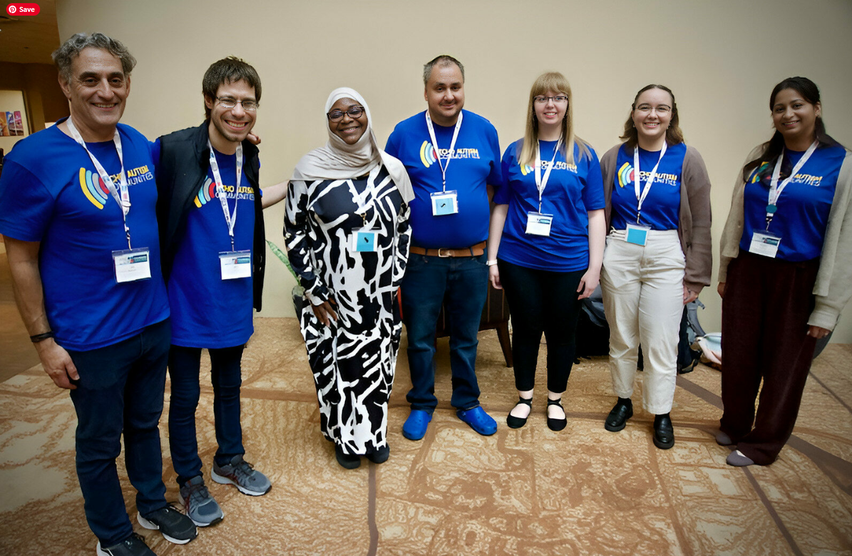




Thank You!
Please reach out to karisc1@uw.edu with any questions
Our partners:

